Slide 1
— — — — — — — — — — — — — — — — — — —
TRAINED MODEL
IN WEBPAGE
— — — — — — — — — — — —

Slide 2
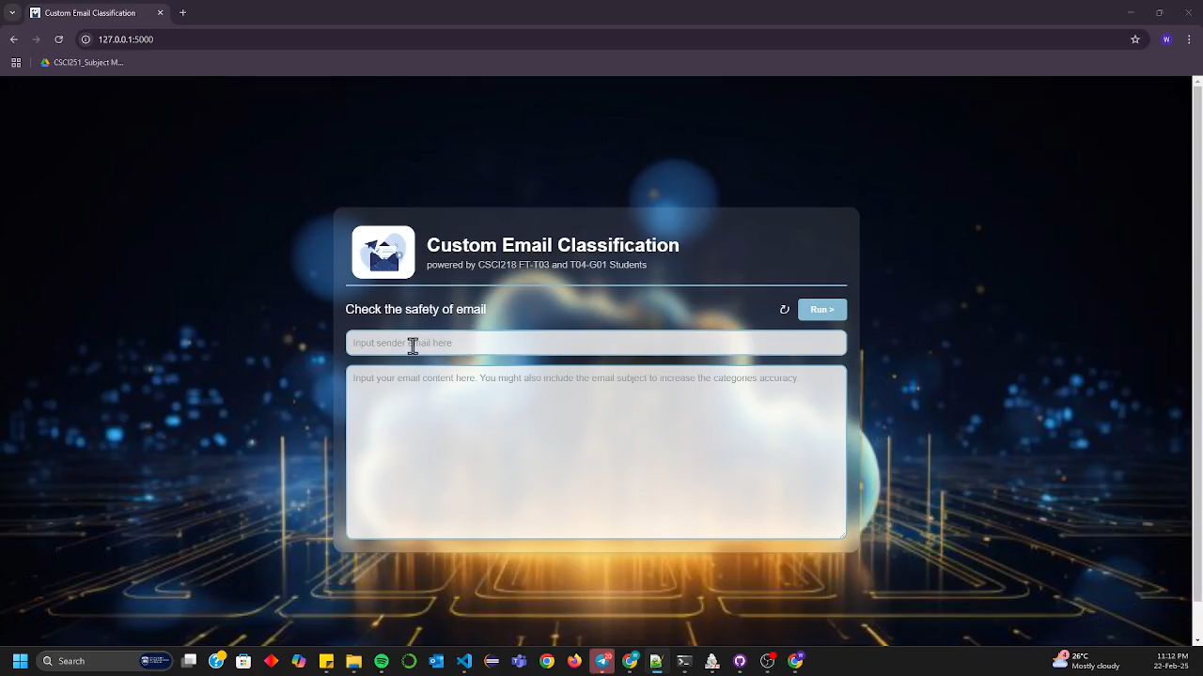
Start testing with same sample…
Click on reset for enter new input
Place Sender Email
Place Email Body and Other Information

Slide 3
— — — — — — — — — — — — — — — — — — —
LET LOOK AT REAL LIFE EXAMPLE
— — — — — — — — — — — —

Slide 4
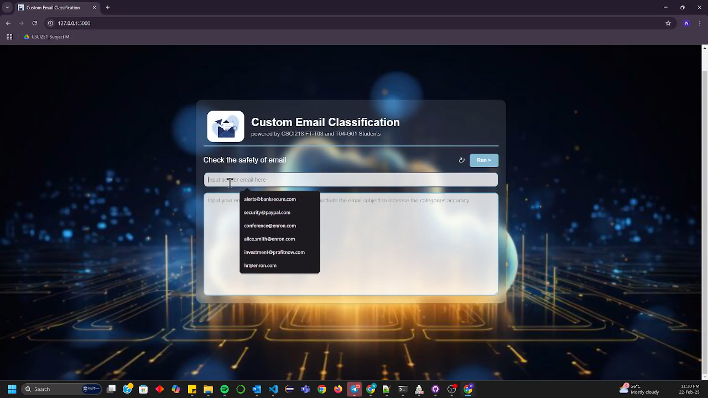
Real email example for Ham

Slide 5
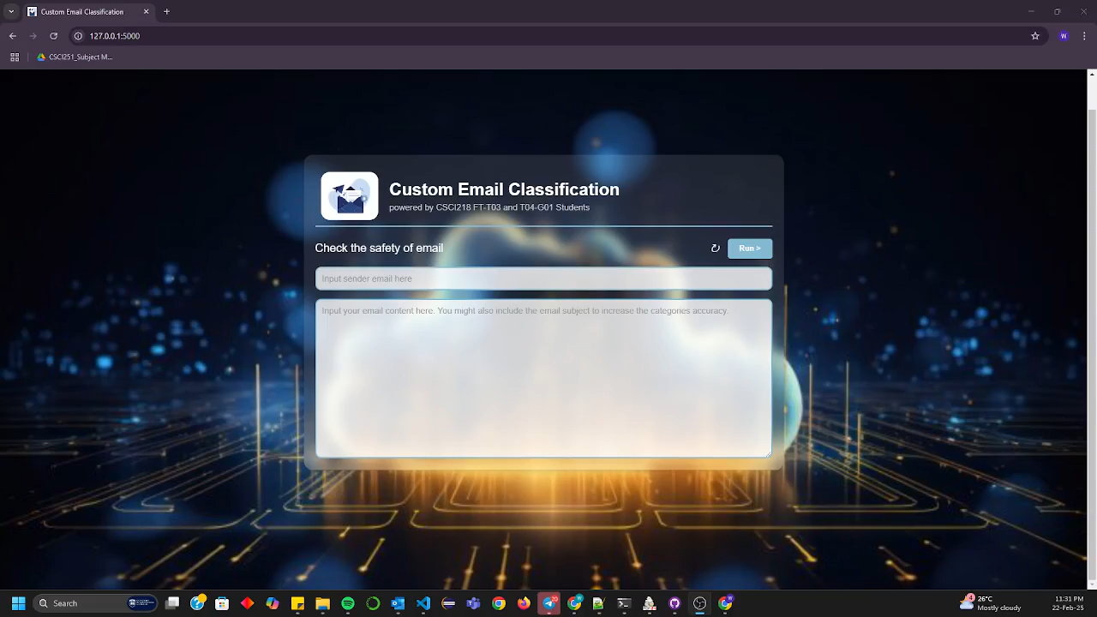
Real email example for Spam

